Slide 1





HackOrbit 2025
Prime Innovators

Slide 2

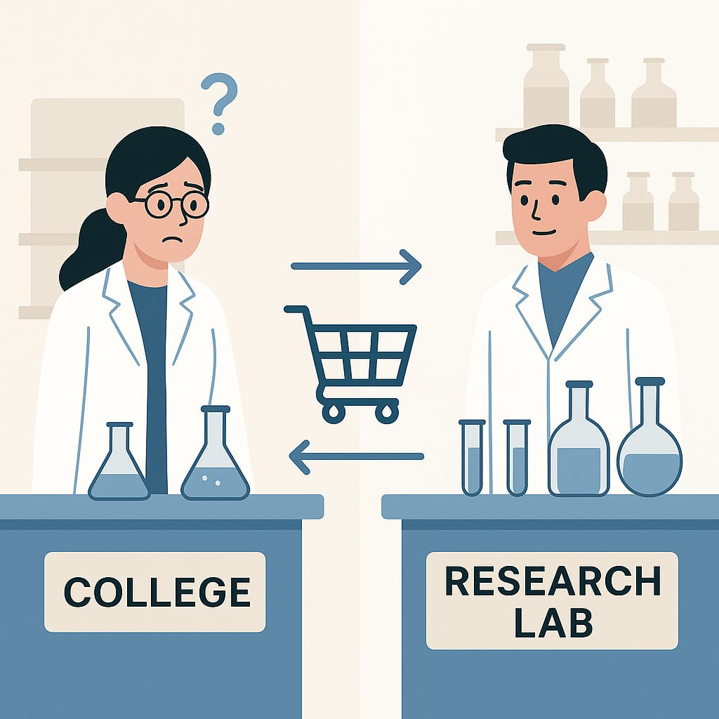
THEME & PROBLEM STATEMENT
THEME : OPEN INNOVATION
Problem Summary:
In schools, colleges, and research labs, valuable chemicals and scientific equipment often go unused, wasted, or expire due to poor coordination and lack of visibility. While some institutions struggle to acquire essential resources due to budget or supply issues, others have surplus stock that remains idle, leading to financial losses and inefficiencies.
Currently, there's no unified system that allows institutions to collaborate, share, borrow, or exchange lab inventory in a secure and transparent way. This leads to:
Redundant purchases despite availability nearby
Wastage of materials due to lack of real-time inventory access
Storage and disposal challenges for unused or expired chemicals
Missed chances for cost-effective sharing of expensive lab equipment
Solution Need:
A decentralized but connected platform is urgently needed to bridge this gap—enabling sustainable, affordable, and efficient lab resource management across the scientific community.

Slide 3
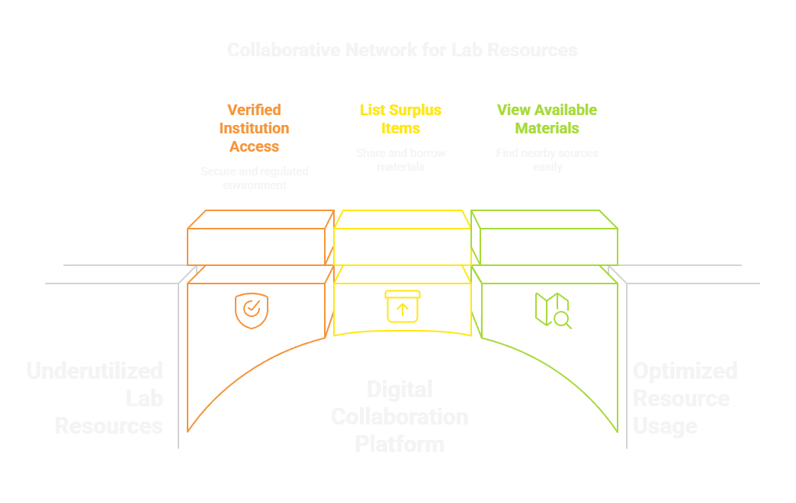
PROPOSED SOLUTION
We propose a digital platform that acts as a collaborative network for chemical laboratories, schools, colleges, and research institutions to efficiently manage and share laboratory resources. The key aspects of this solution include:
Resource Sharing & Collaboration Enables verified institutions to share, borrow, exchange, or sell surplus chemicals and laboratory equipment that would otherwise remain unused.
Surplus Listing & Discovery Institutions can list their excess inventory, while others can browse and access needed materials from nearby or partnered facilities.
Reduced Redundant Procurement Promotes local sourcing to avoid unnecessary purchases, reducing costs and improving resource utilization.
Trusted & Regulated Network Operates within a secure ecosystem of verified members, ensuring all transactions and collaborations meet safety and regulatory standards.
Sustainability & Cost Efficiency Encourages reuse, reduces waste, and supports eco-friendly lab operations across institutions.
Culture of Cooperation Fosters a collaborative spirit within the academic and scientific community by connecting institutions through shared needs and surplus.

Slide 4
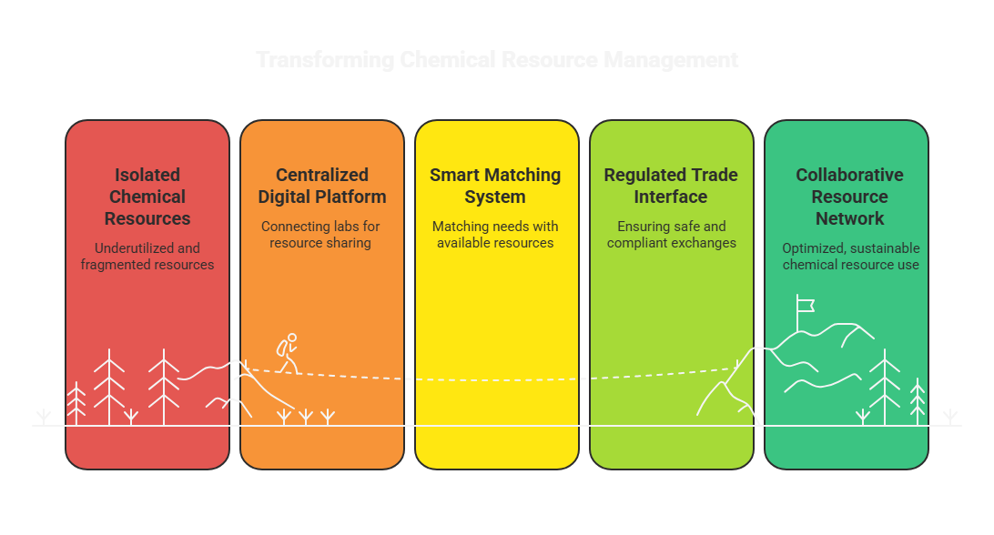
Roadmap to Sustainable Chemical Resource Management

Slide 5
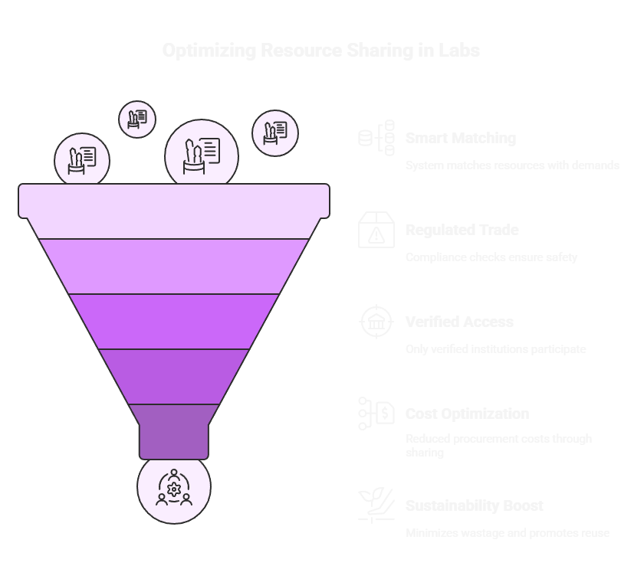
Lab Resources Sharing Funnel

Slide 6
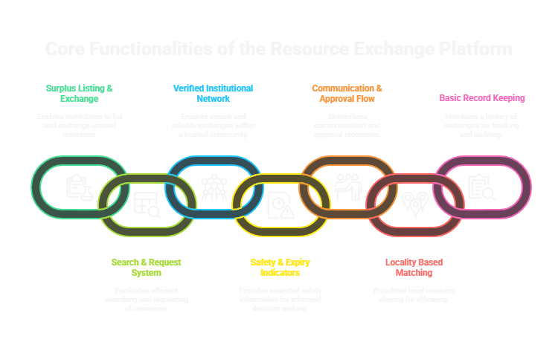
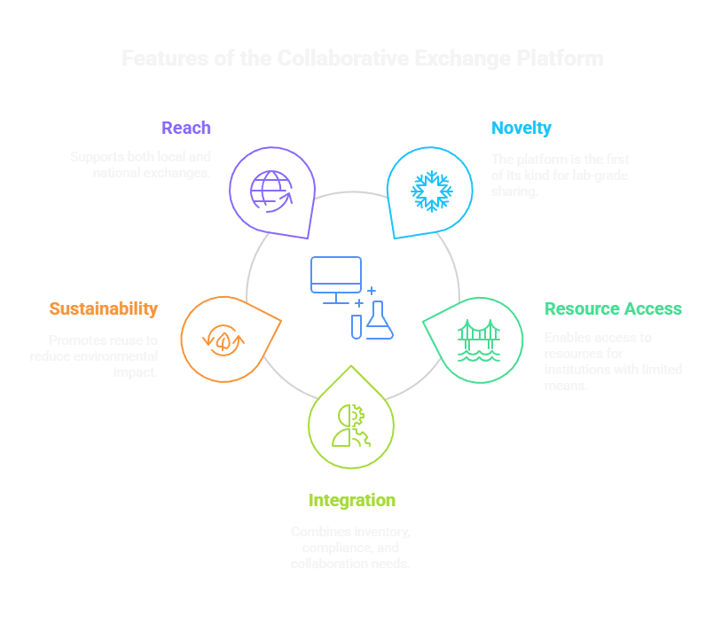
FEATURES AND NOVELTY

Slide 7

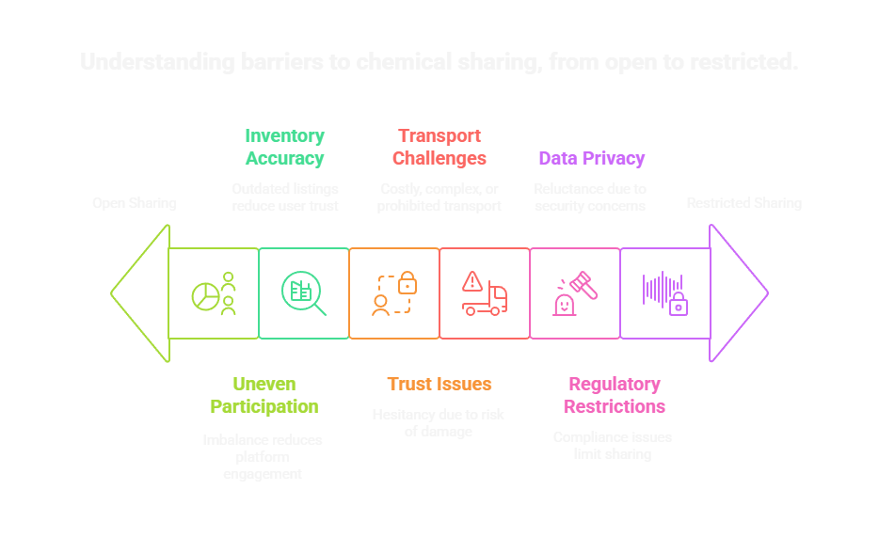
DRAWBACK AND SHOWSTOPPERS
Expected Drawbacks

Slide 8

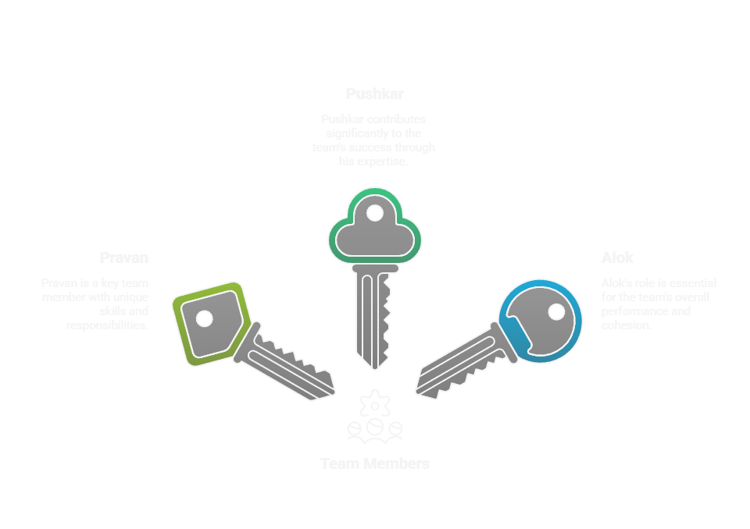
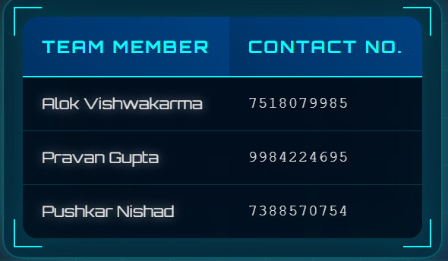

Slide 9
Thank you

